Slide 1
Detecting Criminal Wallets
Instructor:
Ofer Zevin
Students:
Nehoray Chalfon
Ori Sinvani
Harel Brener
Group 4
Github repo

Slide 2
Background
Crypto
Problem
Solution
Blockchain technology caused a financial revolution
Instant transfer
Unregulated
Anonymous
Today the technology is used in part for:
Money laundering
Terror funding
Tax evasion
There is a need for automatic tools to track these behaviours
Notes:
הבלוקצ'יין הוא ספר חשבונות דיגיטלי מבוזר שמתעד עסקאות על פני רשת מחשבים, בצורה שקופה ושאינה ניתנת לשינוי. במקום להסתמך על גורם מרכזי כמו בנק, הרשת כולה מאמתת ומאבטחת כל עסקה.

Slide 3

Goals
Build a system that:
Interaction with user
Processes real-time transaction data
Classification of requested wallet
Results Showcase to user

Slide 4

Data
Elliptic
600K labeled wallets
Bitcoin
19 Features
ן
Real-CATS
Over 200K labeled wallets
Bitcoin & Ethereum
25 Features

Slide 5
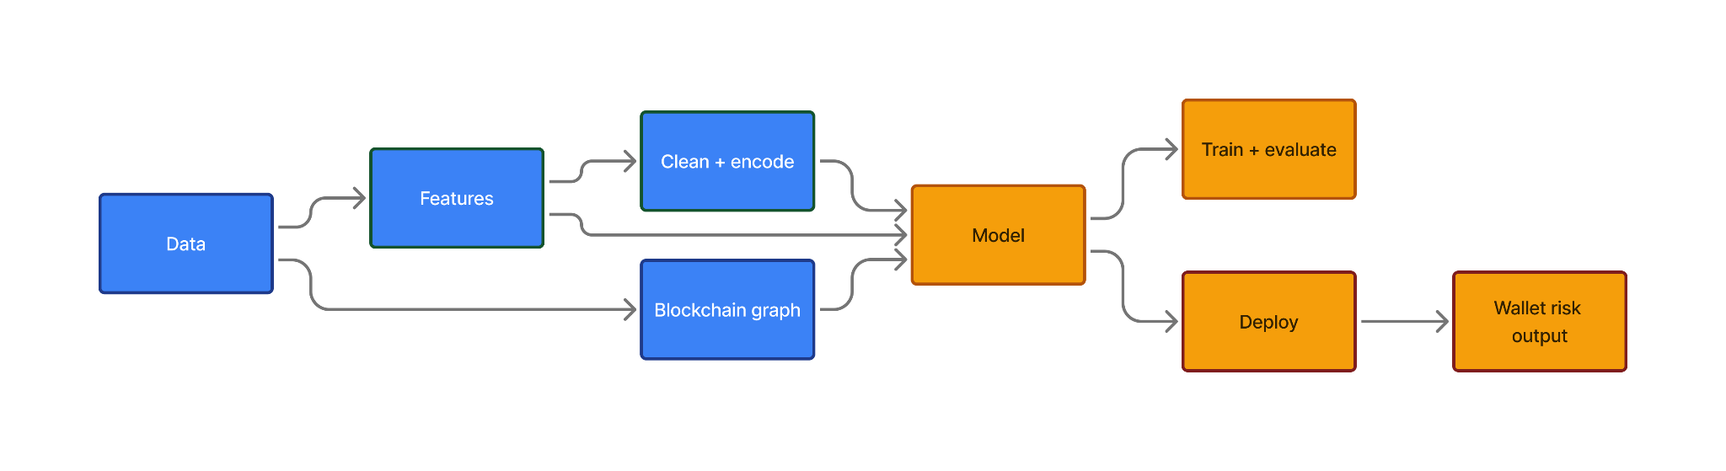
WorkFlow Pipeline

Slide 6
Pre-Marathon Status
Model
Lack of integration
Lacking UI
We made an initial GNN model but did not fully explore its behavior.
Only basic evaluation.
The model was not integrated to the frontend/backend
Initial UI only had basic features and no further analysis of the given wallet

Slide 7
Marathon Goals
Model
Full integration
Improve UI
Gaining deeper understanding of model behavior
Make the model fully integrated with the frontend/backend
Allowing querying the model for classification
Deeper results analysis
Allowing broad understanding of wallet’s behavior and patterns

Slide 8
Marathon results

Slide 9
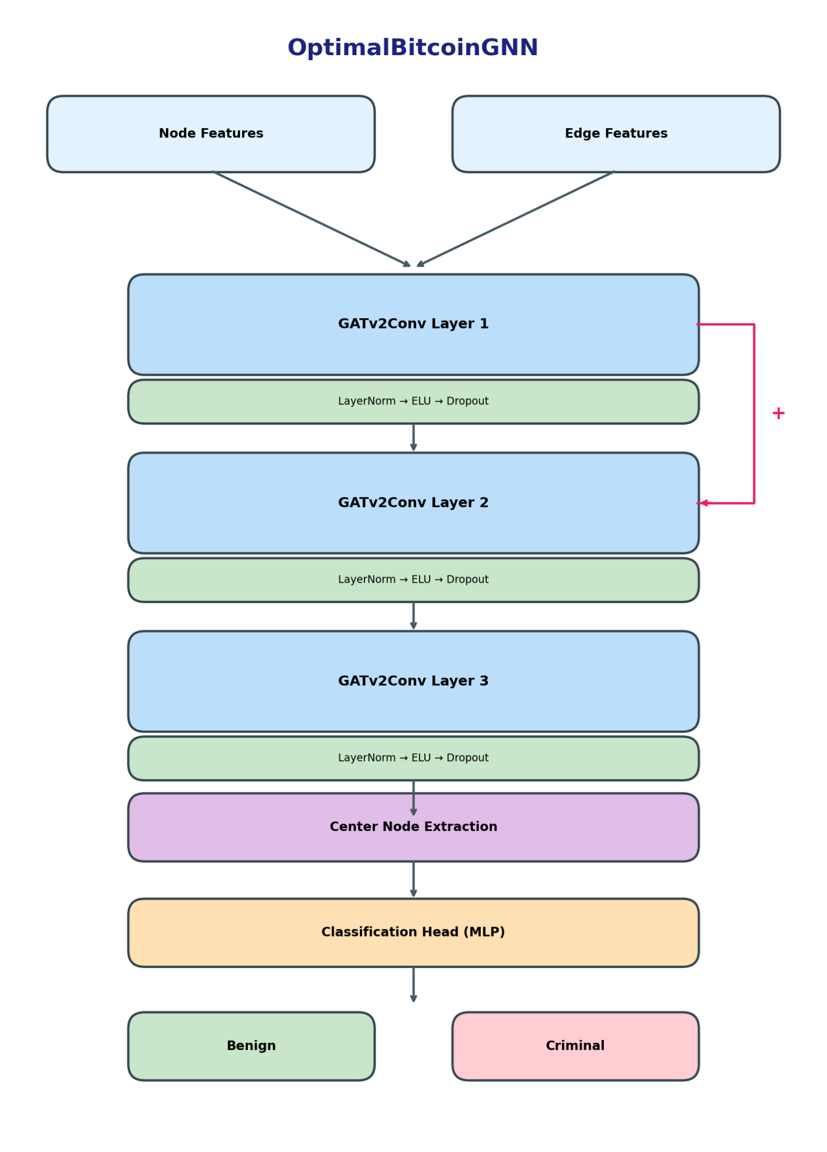
The Model

Slide 10
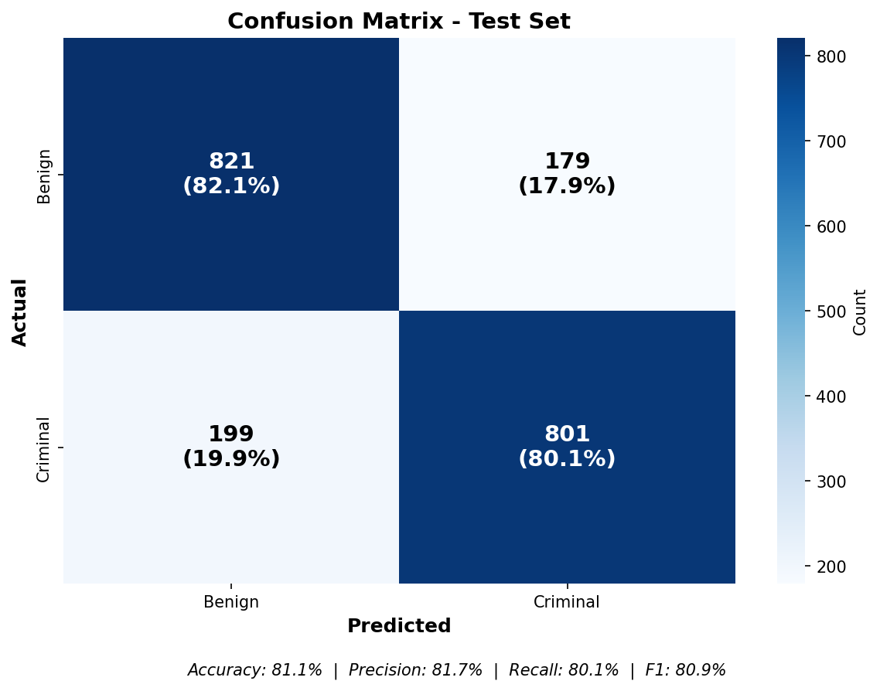
Model Results
Good baseline results
(acc: 81.1%, F1: 80.09%)
Even distribution of FN,TN values

Slide 11
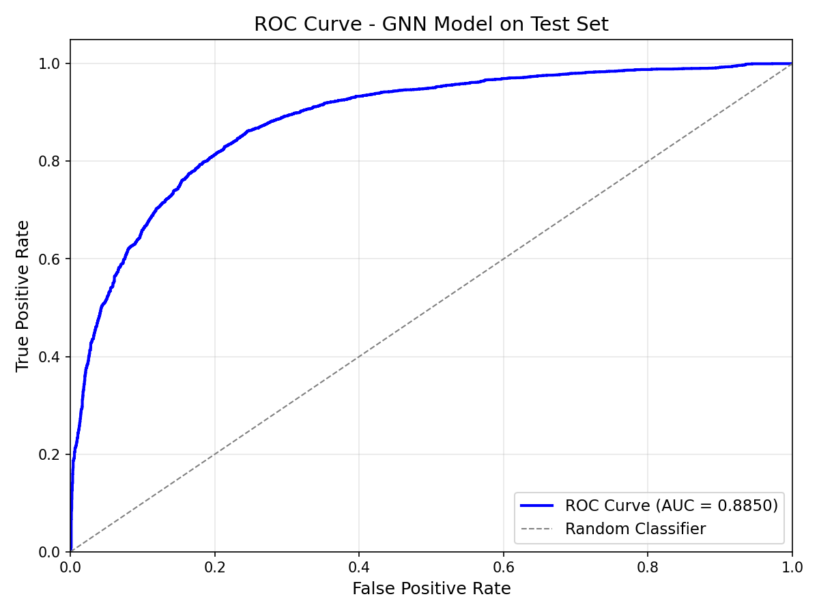
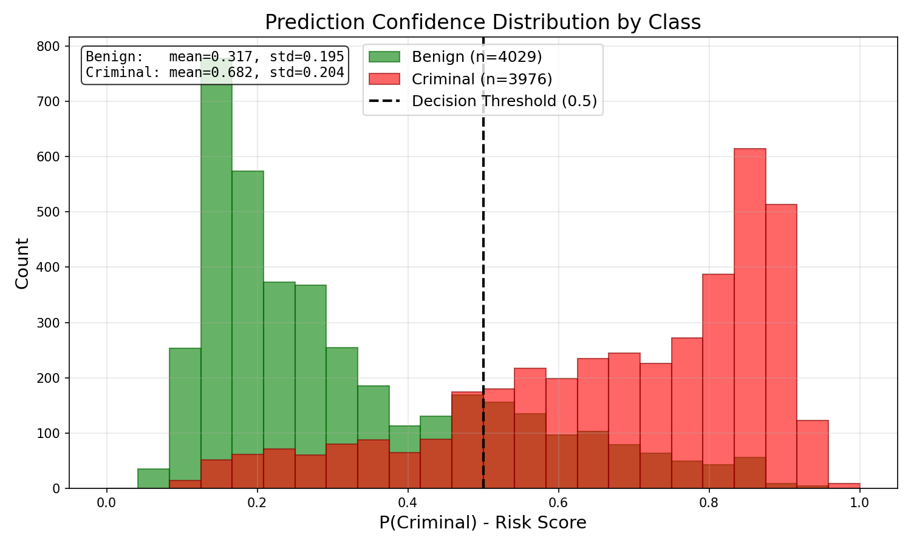
Model Behavior

Slide 12
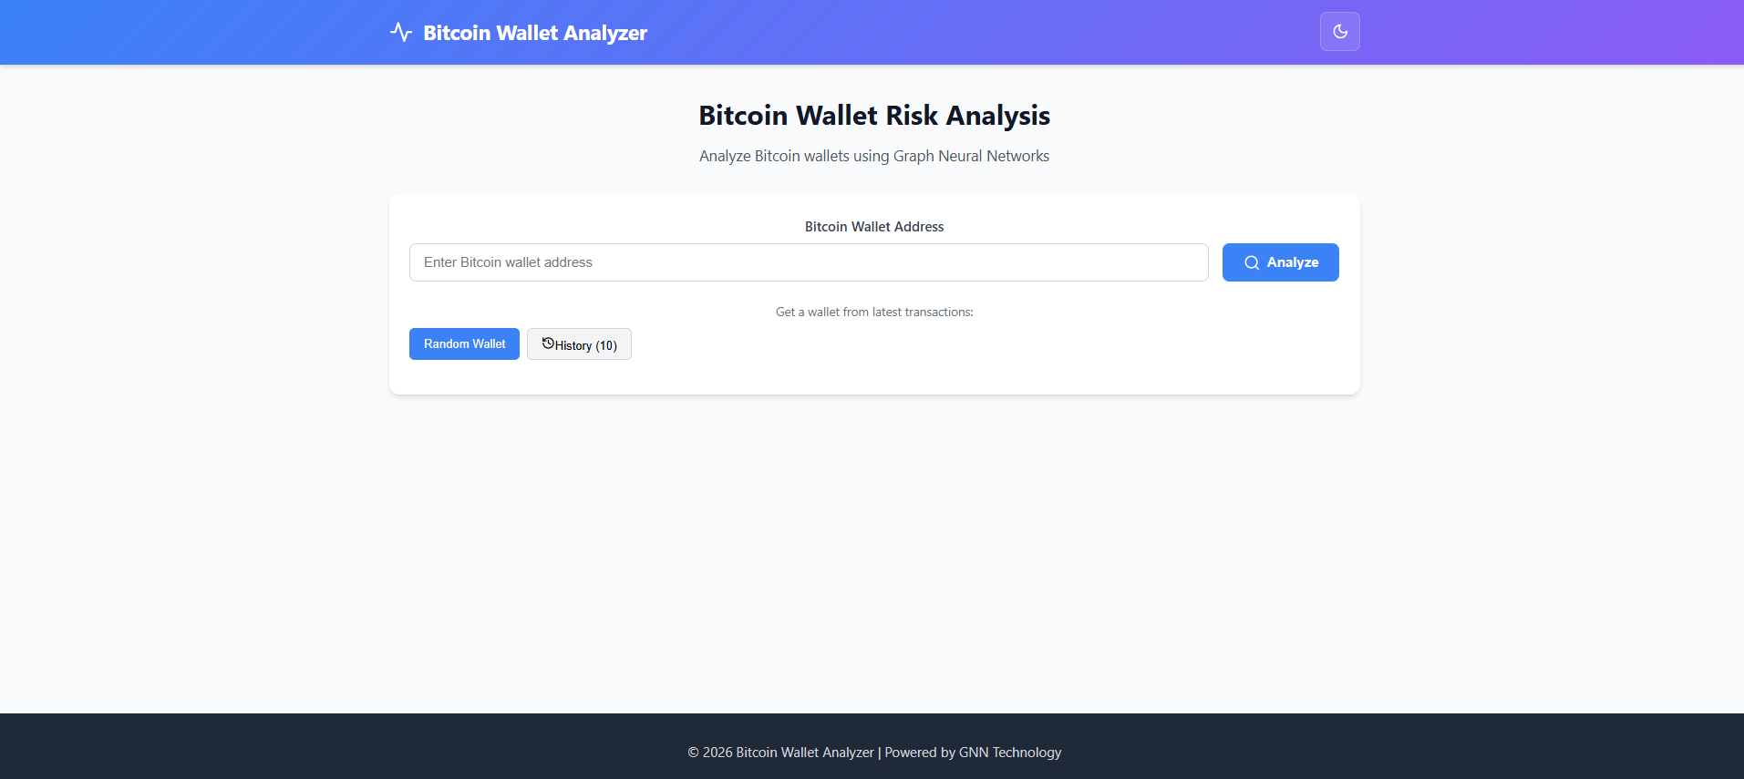
UI Integration and Improvement

Slide 13
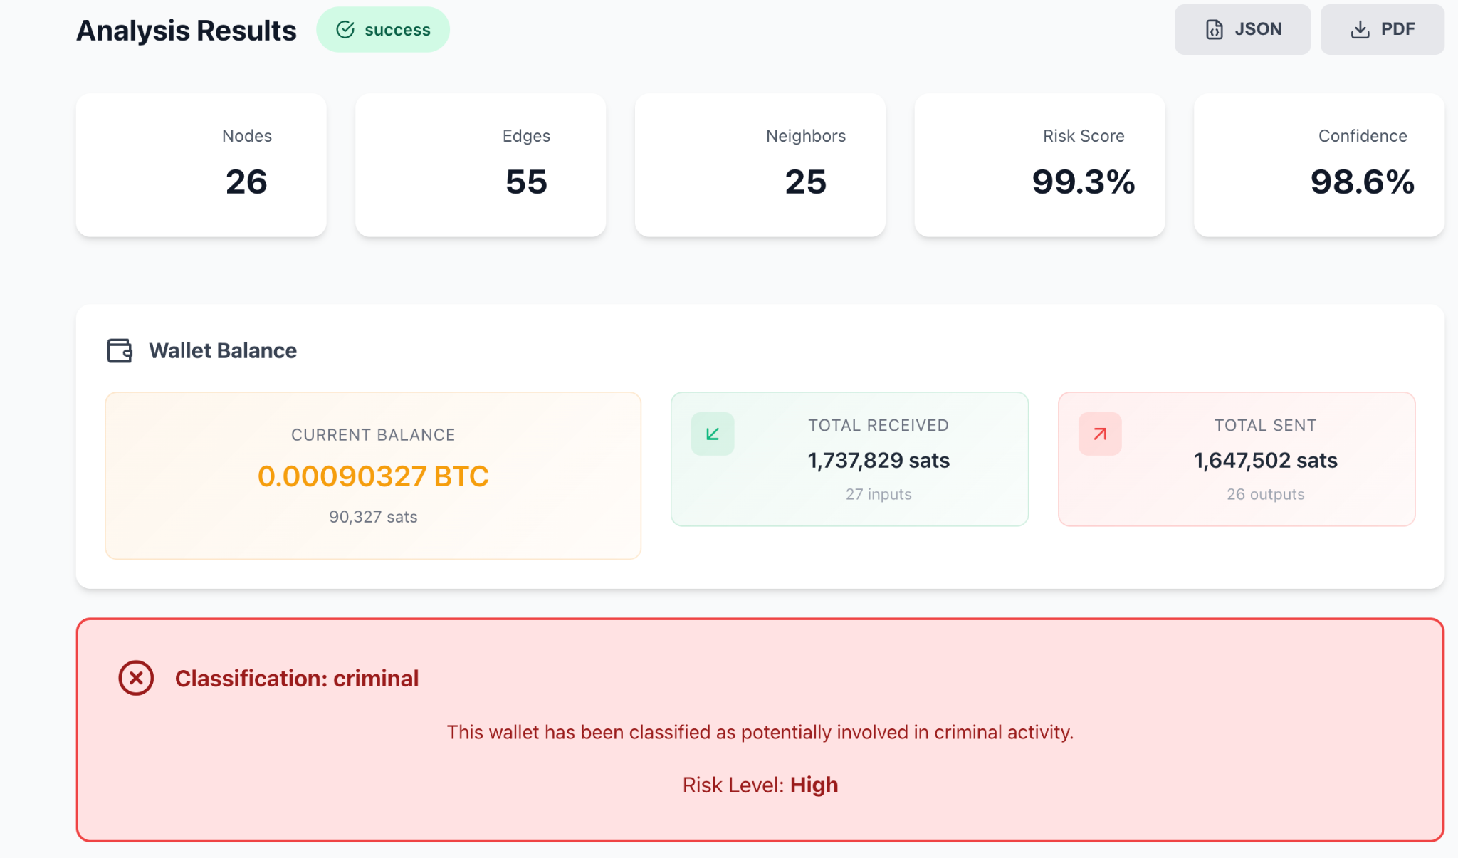
UI Integration and Improvement

Slide 14
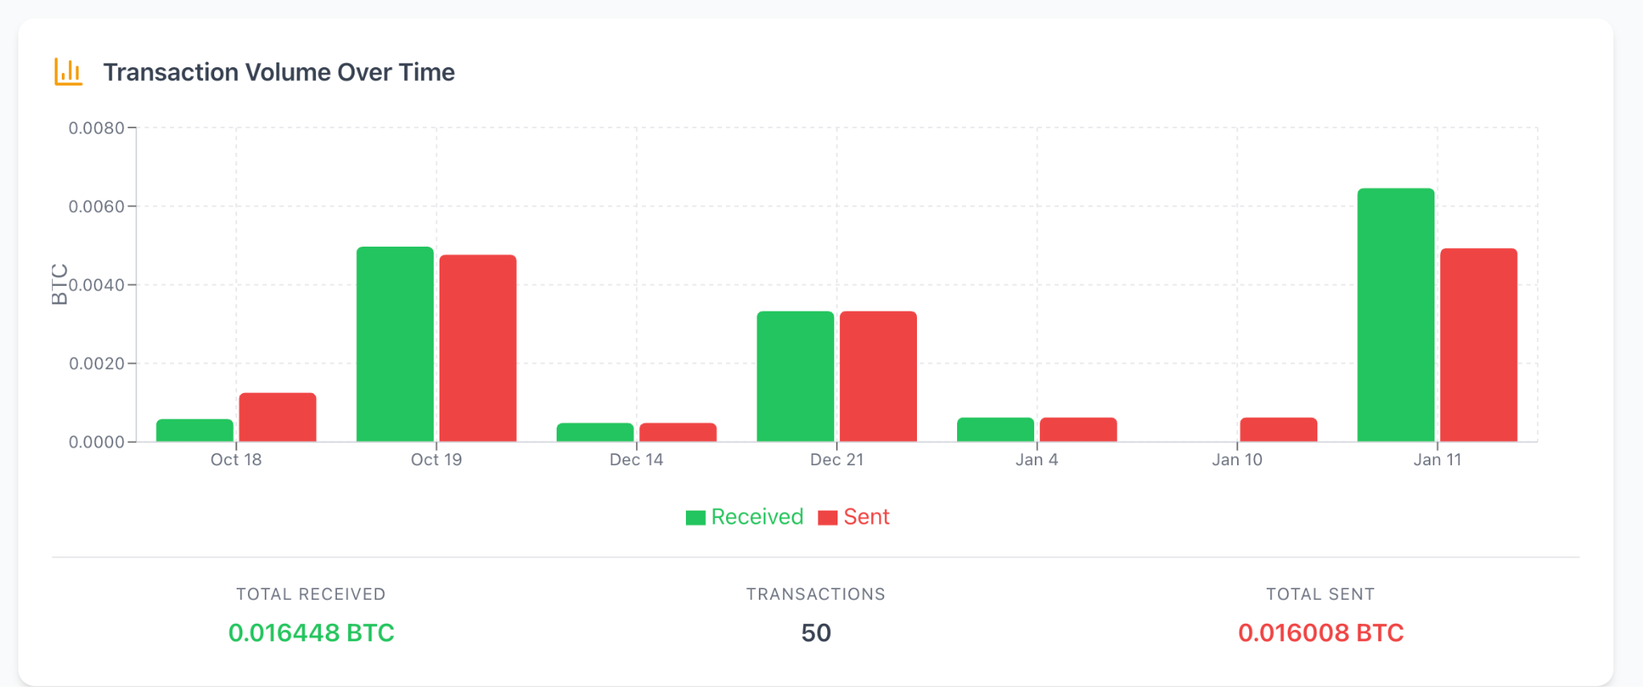
UI Integration and Improvement

Slide 15
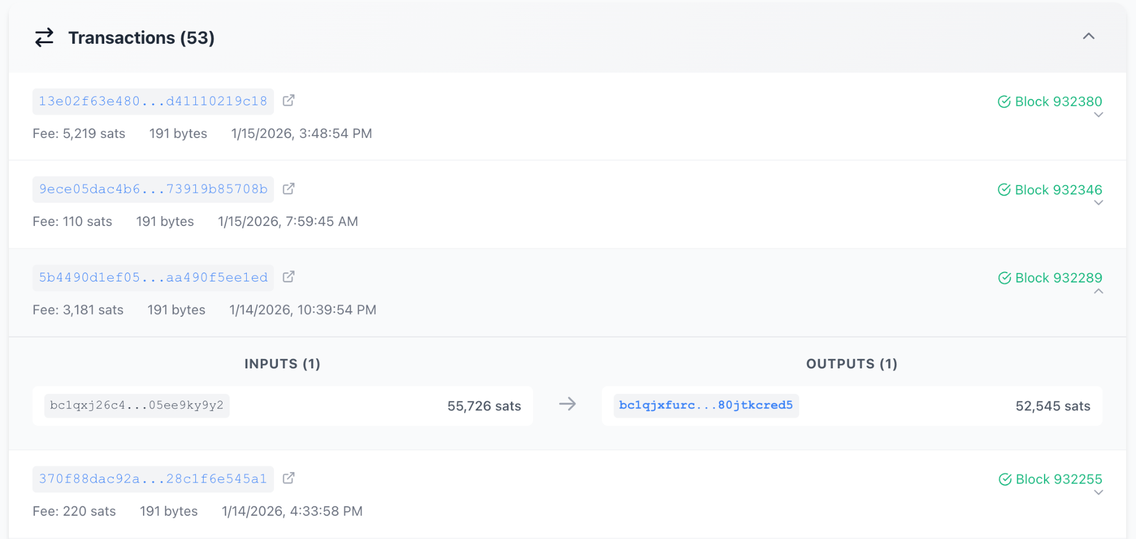
UI Integration and Improvement

Slide 16
Timeline
Testing model performance against baseline
Fine-tuning the chosen model
Creating the final product
Experimentation and evaluation of additional model architectures
Publishing the site online

